Slide 1
Micro-F1 vs Macro-F1 —What Do They Tell Us About Model Performance?
What is Micro？
What is Macro？
Micro-F1
Computed using the global counts of TP, FP, and FN across all samples.
When the number of classes is large and class imbalance is severe, Micro-F1 becomes dominated by high-frequency labels.
Provides a stronger indication of the model’s ability to recognize the most common emotion categories.
Particularly suitable for highly imbalanced datasets, such as GoEmotions
Macro-F1
Computes F1 independently for each class and then takes the unweighted average across all classes.
Assigns equal importance to every class, even when some categories have very few samples.
More accurately reflects the model’s ability to learn and distinguish rare or minority emotion categories.
Serves as a measure of the model’s overall fairness and generalization capability across all classes.

Slide 2

Why do we need both Micro-F1 and Macro-F1?
A single metric cannot fully capture the model’s true performance
In highly imbalanced datasets, a model may appear “good” while only learning frequent labels
Using both metrics provides evaluation from two perspectives: overall performance and class-level fairness
Helps identify whether the model fails on minority emotion categories and prevents misleading conclusions

Slide 3
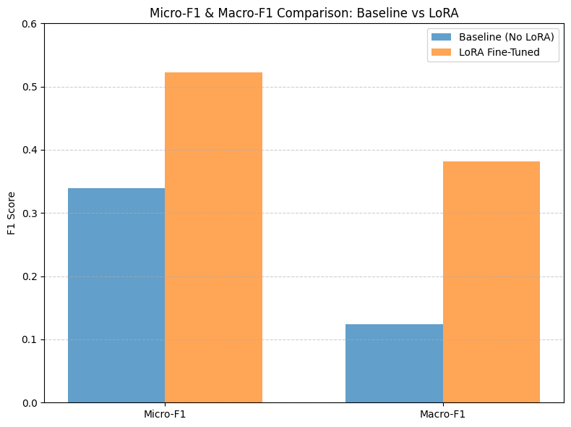

Slide 4
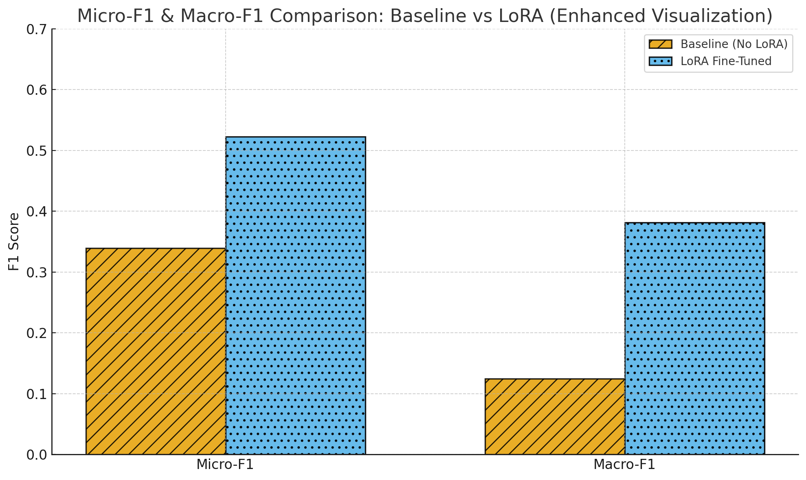

Slide 5
1 没有lora and lora 结果 对比
可视化

